Slide 1



NGUYEN TRAI JUNIOR
HIGH SCHOOL
WELCOME TO
OUR CLASS
Teacher: TRAN Y NHI

Slide 2

WARM UP:
crossword puzzle
Read the hints and look at the pictures.
Count the number of letters of each word/ phrase.
Give the answer and notice the highlighted letter in each word/ phrase.
Use these highlighted letters to find out key word.

Slide 3

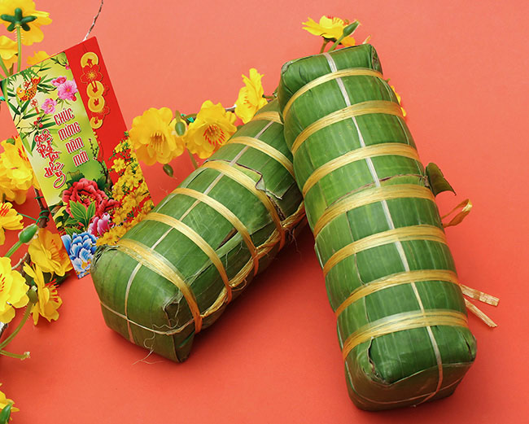
1. Look at the picture and give the name of this kind of food.
B A N H T E T

Slide 4

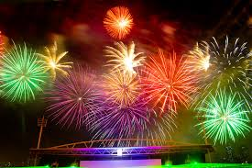
2. What can people see in the sky on New Year’s Eve?
F I R E W O R K S

Slide 5

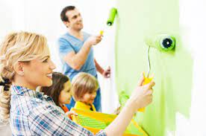
3. Give the verb of this activity.
P A I N T

Slide 6


Warm up
B A N H T E T
F I R E W O R K S
P A I N T
TET

Slide 7
Saturday, December 4th, 2021
UNIT 6:
OUR TET HOLIDAY
Period:
Lesson 1: Getting started
Happy New Year!

Slide 8


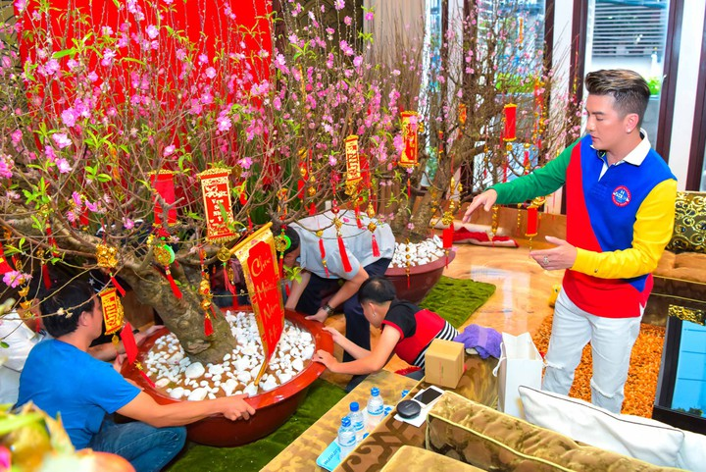
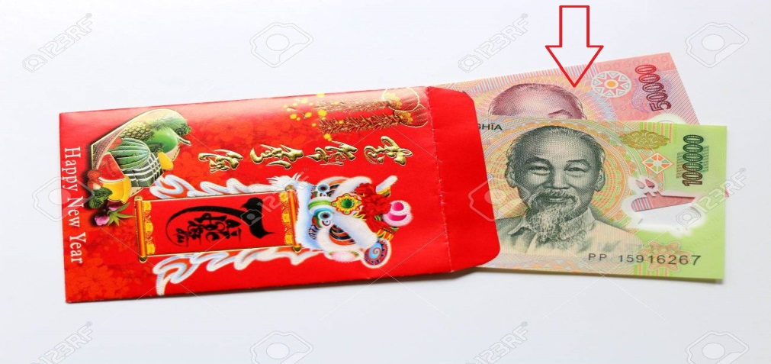
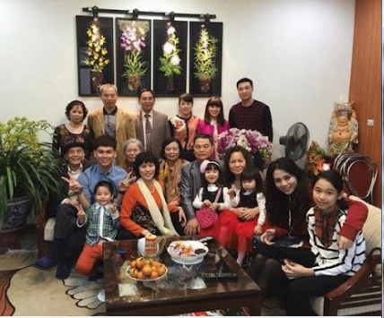
Unit 6: OUR TET HOLIDAY
GETTING STARTED
Vocabulary
- peach flower
(N.phr.)
: hoa đào
/piːtʃ 'flaʊər/
- decorate
(v)
: trang trí,
trang hoàng
/'dekəreit/
- lucky money
(N. phr.)
: tiền lì xì
/'lʌki 'mʌni/
- celebrate
(v)
: tổ chức, kỉ niệm
/'selɪbreɪt/
- family gathering
(N. phr.)
: sum họp gia đình
/'fæməli
'ɡæðərɪŋ/

Slide 9
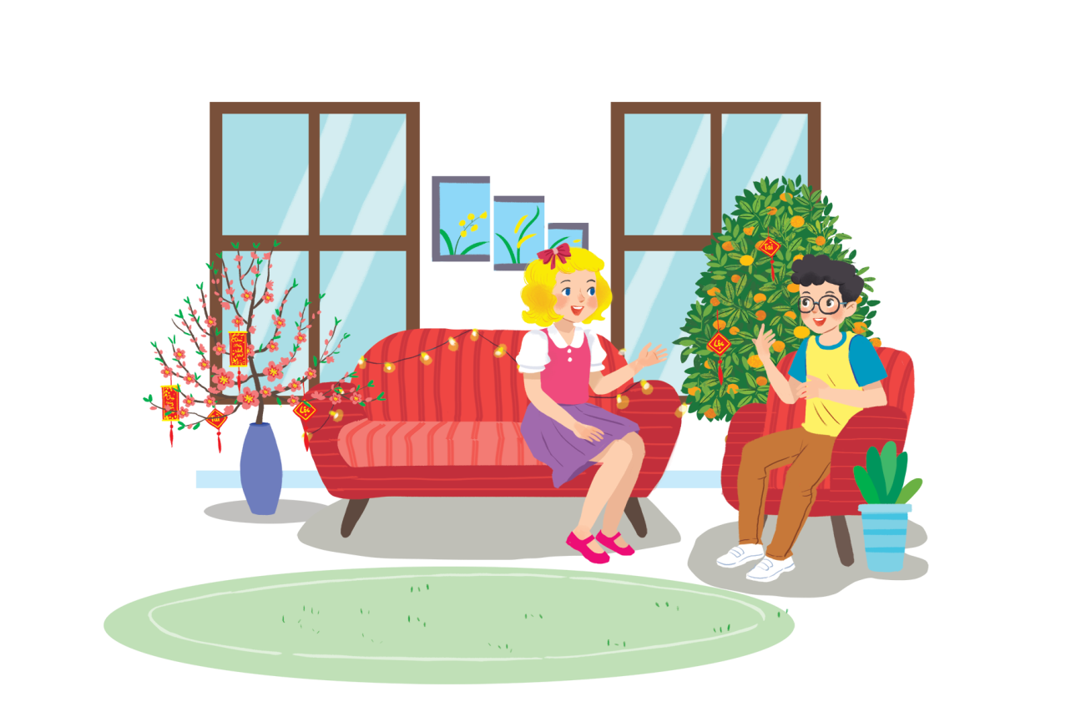
Unit 6: OUR TET HOLIDAY
GETTING STARTED
1. Listen and read.
Happy New Year!
What do you think they are talking about?
When is Tet?
Is it a holiday?

Slide 10


Slide 11
Unit 6: OUR TET HOLIDAY
GETTING STARTED
2. What are Linda and Phong talking about?
A. New Years in the world
B. Tet in Viet Nam.
C. What to eat and wear during Tet

Slide 12
Unit 6: OUR TET HOLIDAY
GETTING STARTED
3. Complete the sentences about Tet with the information from the conversation in 1.
1. This year Tet is in _________.
2. We decorate our _________.
3. Tet is a time for family _________.
4. Children get ________ ________.
5. People shouldn’t ________ anything.

Slide 13
Unit 6: OUR TET HOLIDAY
GETTING STARTED
3. Complete the sentences about Tet with the information from the conversation in 1.
1. This year Tet is in _________.
January
2. We decorate our _________.
homes
gatherings
3. Tet is a time for family _________.
4. Children get ________ ________.
lucky
money
5. People shouldn’t ________ anything.
break

Slide 14
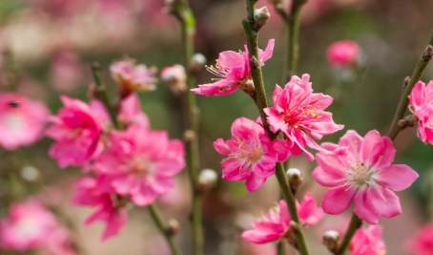
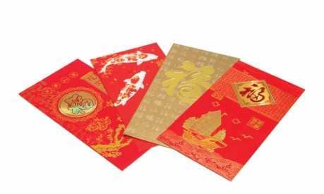
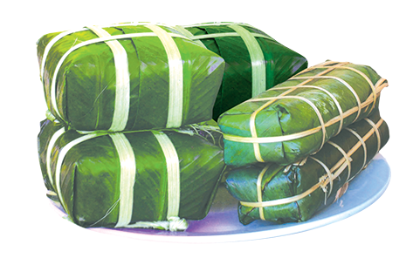
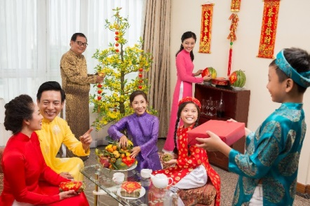
Unit 6: OUR TET HOLIDAY
GETTING STARTED
4. Match the words/ phrases in the box with the pictures.
a. lucky money
b. peach flowers
c. banh chung and banh tet
d. family gathering
1
2
b. peach flowers
a. lucky money
3
4
c. banh chung and banh tet
d. family gathering

Slide 15
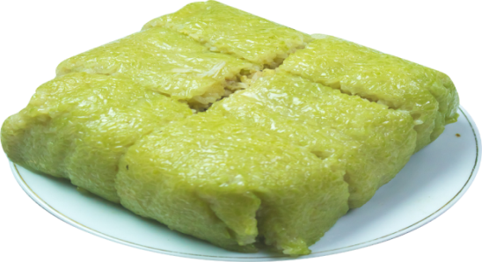

Unit 6: OUR TET HOLIDAY
GETTING STARTED
5. Game: Is it about Tet? Write two things or activities and share them with the class. The class listen and decide whether they are about or not about Tet.
banh chung
It’s about Tet.
flying a kite
It’s not about Tet.

Slide 16
Unit 6: OUR TET HOLIDAY
GETTING STARTED
5. Game: Is it about Tet? Write two things or activities and share them with the class. The class listen and decide whether they are about or not about Tet.
Example:
Student: banh chung
Class: It’s about Tet.
Student: flying a kite
Class: It’s not about Tet.

Slide 17


Unit 6: OUR TET HOLIDAY
GETTING STARTED
Do you like Tet?

Slide 18
Unit 6: OUR TET HOLIDAY
GETTING STARTED
HOMEWORK
Learn by heart vocabulary and practice the conversation.
Do exercises in exercise book.
Prepare for Unit 6 – Lesson 2: A closer look 1
(page 60).

Slide 19
Unit 6: OUR TET HOLIDAY
GETTING STARTED
* Warm-up: Crossword puzzle
1. January 2. homes
3. gatherings 4. lucky money
5. break
Task 4: Match the words/ phrases in the box with the pictures.
1. b 2. a 3. c 4. d
* Homework:
- Learn by heart vocabulary and practice the conversation.
- Do exercises in exercise book.
- Prepare for Unit 6 – Lesson 2:
A closer look 1 (page 60).
I. Vocabulary:
- peach flower (N.phr): hoa đào
- decorate (v): trang hoàng, trang trí - lucky money (N. phr.): tiền lì xì
- celebrate (v): kỉ niệm, tổ chức
- family gathering(N.phr.): sum họp gia đình
II. Practice:
Task 1: Listen and read.
Task 2: What are Linda and Phong talking about? B. Tet in Viet Nam
Task 3: Complete the sentences about Tet with the information from the conversation in 1.

Slide 20


